Slide 1
Quora Question Pair Similarity Prediction
Senthil Ramachandran – skr6
&
Rujitha Vennugopalan – rujitha2

Slide 2
Problem definition
Quora is a place to gain and share knowledge—about anything. It’s a platform to ask questions and connect with people who contribute unique insights and quality answers. This empowers people to learn from each other and to better understand the world.
Over 100 million people visit Quora every month, so it's no surprise that many people ask similarly worded questions. Multiple questions with the same intent can cause seekers to spend more time finding the best answer to their question, and make writers feel they need to answer multiple versions of the same question. Quora values canonical questions because they provide a better experience to active seekers and writers, and offer more value to both of these groups in the long term.
Problem Statement
Identify which questions asked on Quora are duplicates of questions that have already been asked.
This could be useful to instantly provide answers to questions that have already been answered.
We are tasked with predicting whether a pair of questions are duplicates or not.

Slide 3
Novelty of my project
Given a pair of Quora questions, identify whether they have the same intent i.e. is one question a duplicate of the other. In order to tackle this problem we apply Natural Language Processing techniques coupled with Machine Learning to classify a given question pair as duplicate or not.
Some of the research questions we tries to cover include: what features for text similarity would be strong predictors for this classification problem, how to judge similarity when contextual information is involved in the question pairs (i.e semantic similarity)
We have achieved a training accuracy of 86.11 % and validation accuracy of 84.42% . The maximum accuracy achieved in the aforementioned paper was only 83.8%
We believe our results are not directly comparable to Quora’s result of 88%F1and 87% accuracy [11]in that we did not use the same embeddings and did not do the same preprocessing. Their results were based on word embeddings trained on a corpus of Quora data. We believe that a significant part of the gap in results (though not at all close to all of it) may be due to a difference in embeddings and lack of coverage of our pretrained embeddings. Also, based on our blind study and our experience so far with the data, their results may be at the very limit of what is possible on this dataset and their models might be highly specialized to predict on Quora platform questions (versus general questions of a certain length).
Since user-inputed language on an online platform is more free and has more variations than standard English, or the language in Wikipedia (which GloVe was trained on), we feel our results can be greatly improved fundamentally by using character-based models, engineering overlap features, as well as minor developments such as using features like Named Entity tags and attempting spelling corrections. We might also use separate models for high string similarity cases and large relative-length difference cases; this may work better in practice though theoretically it should not be necessary. In addition to improving performance, these implementations would give a very new perspective to the problem.

Slide 4
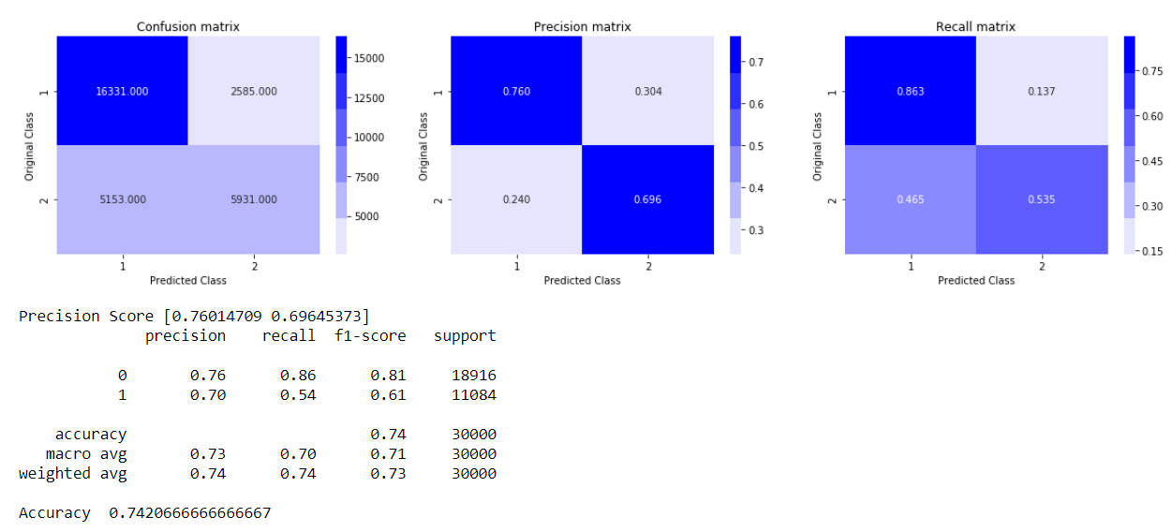
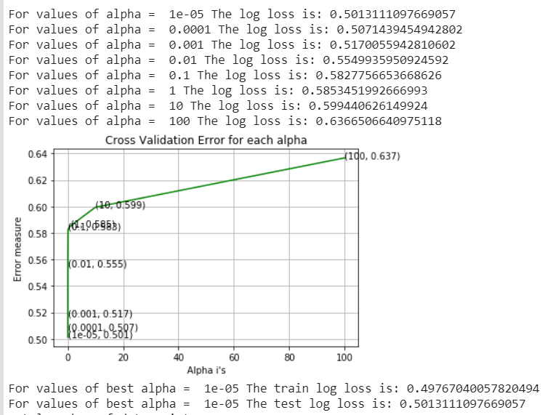
General approach
The duplicate detection problem can be defined as follows: given a pair of questions q1 and q2, train a model that learns the function:
f(q1, q2) → 0 or 1
where 1 represents that q1 and q2 have the same intent and 0 otherwise.
A simple duplicate detection approach is a word-based comparison. For example, we can use standard information retrieval measures like tfidf- or BM25, Logistic Regression to find the word-based similarity between the two questions, then classify question pairs with similarity scores above a certain threshold as duplicates. But, if we want to detect duplicates at a more intent-based, semantic level, we need more intelligent approaches than these simple measures.
Sample Result

Slide 5
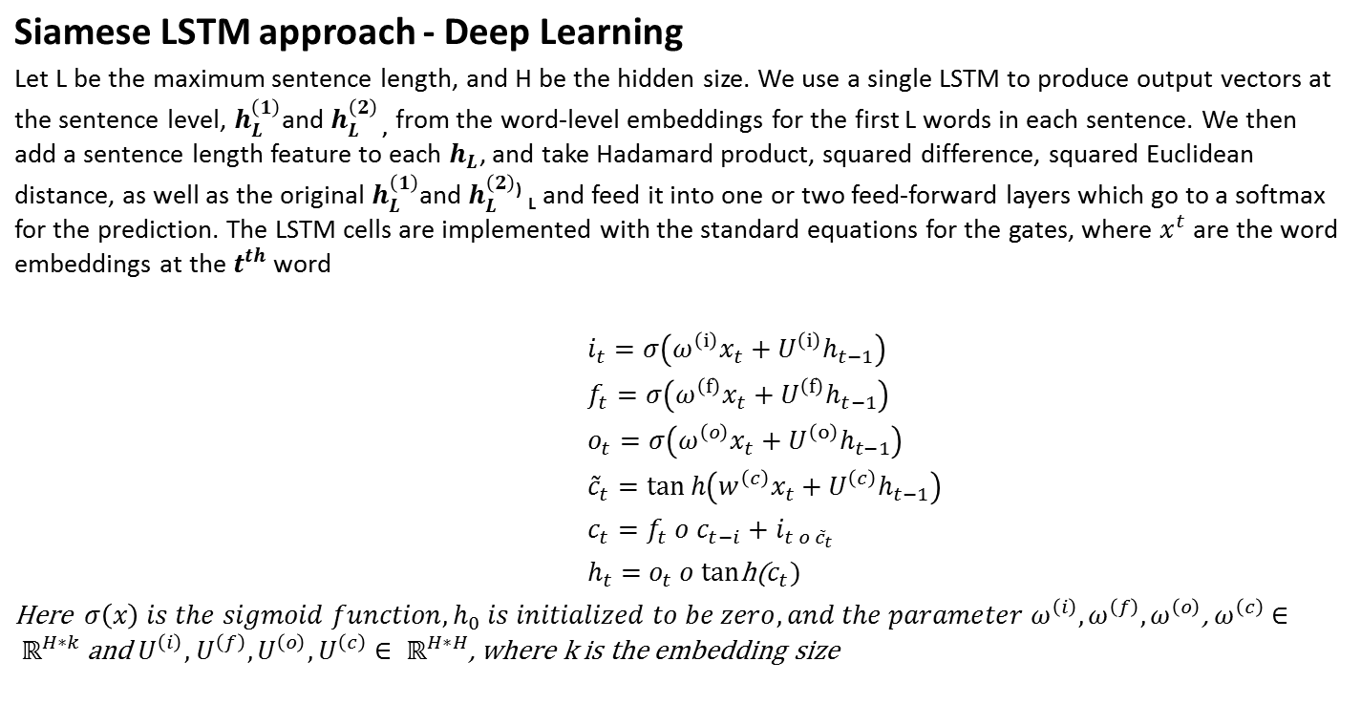
Further extension

Slide 6
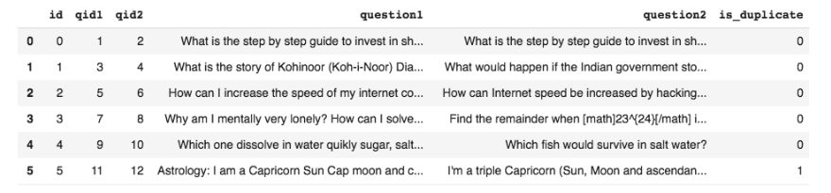
Experiment Design
Data set
The training set contains 404290 pair of labeled question pairs as "duplication" or not. The test set contains 2345796 unlabeled question pairs for prediction
id: A common id assigned for each sample.
qid1: A unique number to identify question 1.
qid2: A unique number to identify question 2.
question1: Actual content of question 1.
question2: Actual content of question 2.
is_duplicate: If questions have the same meaning then 1 otherwise 0
Table

Slide 7
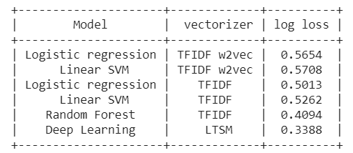
Experiment Design
Machine Learning Metrics
Procedures
Machine Learning Model
  Logistic regression with TFIDF w2vec
  Linear SVM with TFIDF w2vec
  Logistic regression with TFIDF
  Linear SVM with TFIDF
  Random Forest

Slide 8
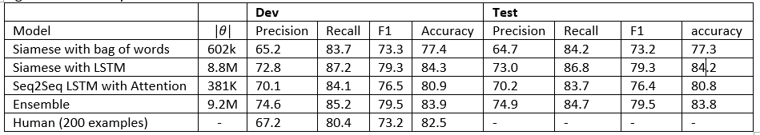
Experiment Result
Deep Learning Metrics
Procedure
For Demo please follow the instruction provide in the video.
For full code please and result please click the below link
https://colab.research.google.com/drive/1-AuAqlYcJYvfuMduDwErjme2UkJaERse

Slide 9
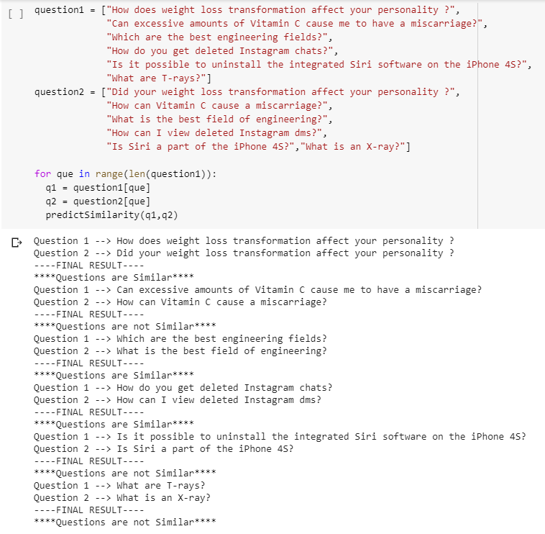
Sample Result

Slide 10
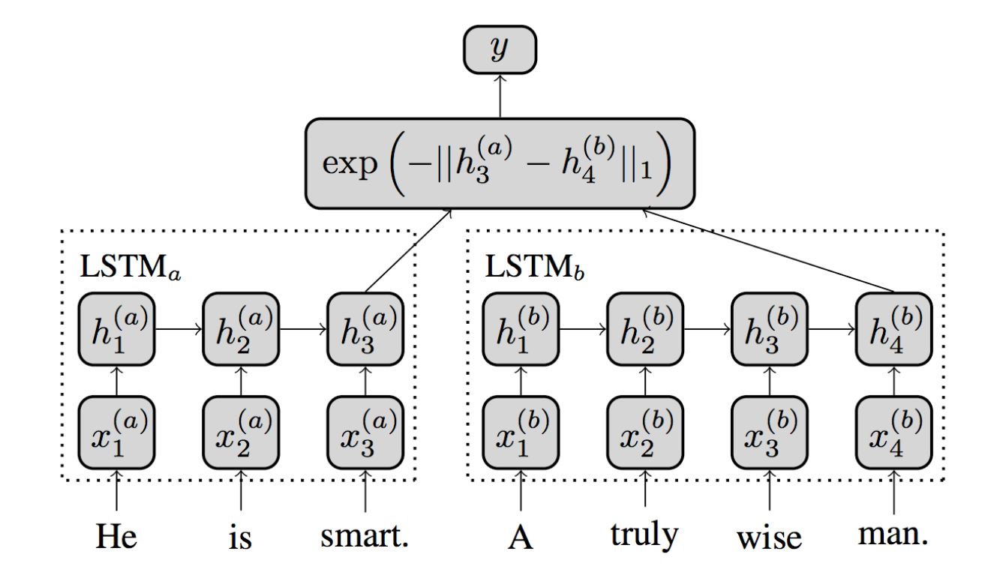
LTSM Architect

Slide 11
Siamese LSTM Deep Learning Model
Logit Prediction
Dense Layer 1
Dense Layer 2
Sentence
Length 1
Sentence
Length 2
Product Difference Distance
Representation 1
Representation 2
Question 1
Question 2

Slide 12
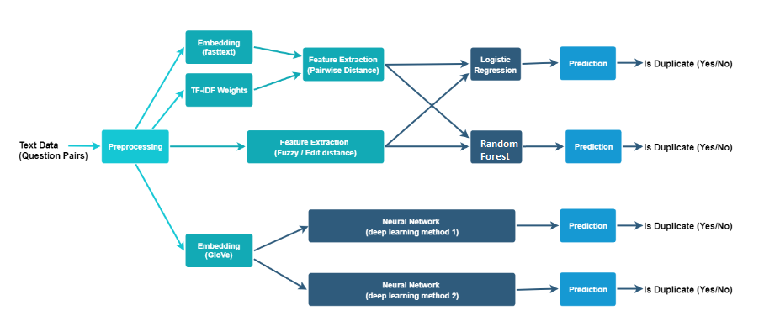
Final Architect

Slide 13

Software and Environment
We used Colaboratory environment for the development https://colab.research.google.com/ Colaboratory is a research tool for machine learning education and research. It’s a Jupyter notebook environment that requires no setup to use and developed by Google
  It comes with inbuild python 2.7 or 3 , and majorly used libraries
  If any libraries were missing then use the below command to install the packages
    !pip install packagename example
Python 3.0 or above and below packages require to execute the project on local machine and Train.csv and Test.csv for Machine learning , questions.csv for Deep learning model
Packages
Tensor flow 1.15.0
Numy
Pandas
Seaborn
Distance
PrettyTable
matplotlib
Tensor flow 2
Check_output
Nltk
Sklearn
Tqdm
Fuzzywuzzy
fuzz
Bs4
Keras

